Slide 1
2nd Sensor – final try
Date: 29/01/2020
Measured with source meter in current sourcing configuration
Source current: 100 nA
Heating voltage: 5.3 V
5.2 in the first set of measurements before 0129_1710
5.3V after that as according to the manual it is the right voltage for 20C

Slide 2
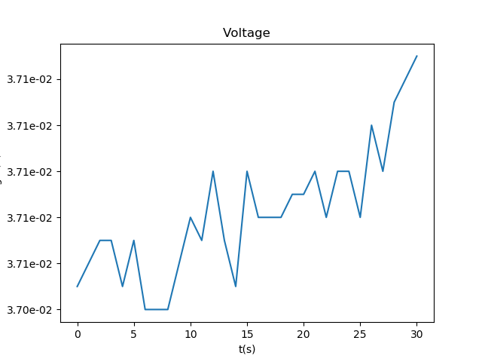
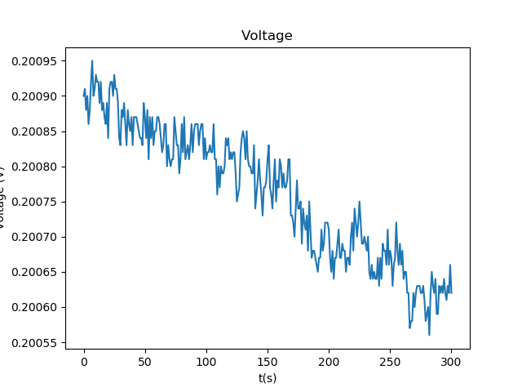
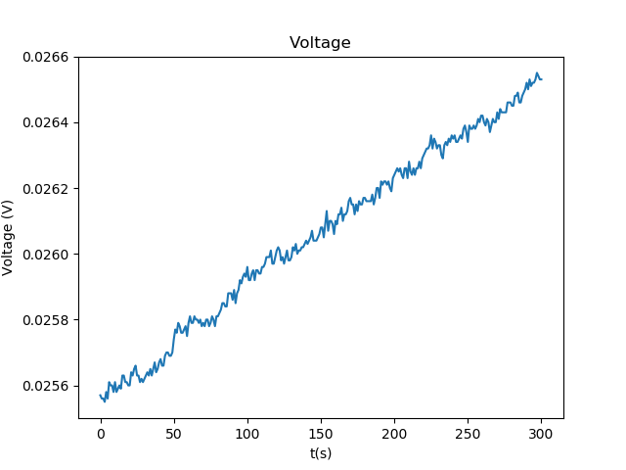
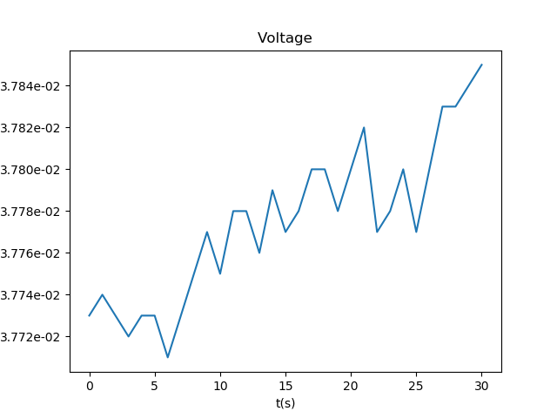
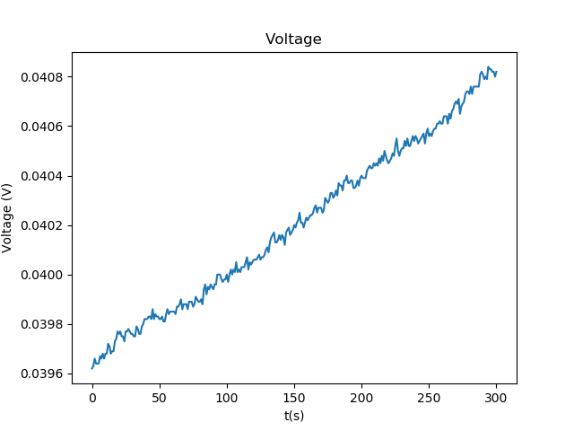
Base value in Air –waiting for stable value at 5.2V
15:59
15:08
15:37
16:03
16:12
Initial decrease, but after the resistance only increases
Over range between 0.02 and 0.04 V or
0.2 to 0.4 MOhm

Slide 3
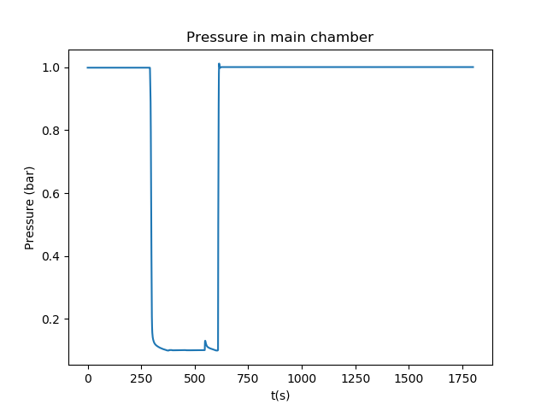
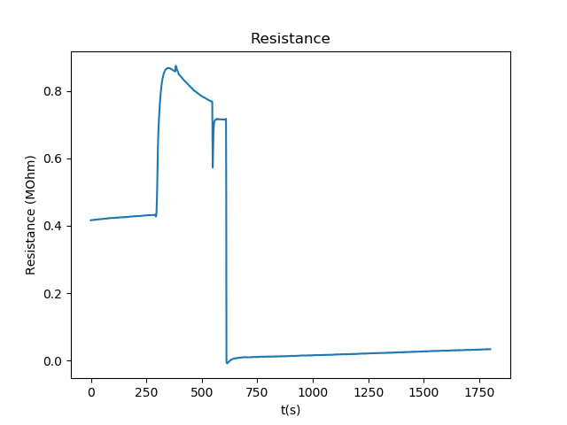
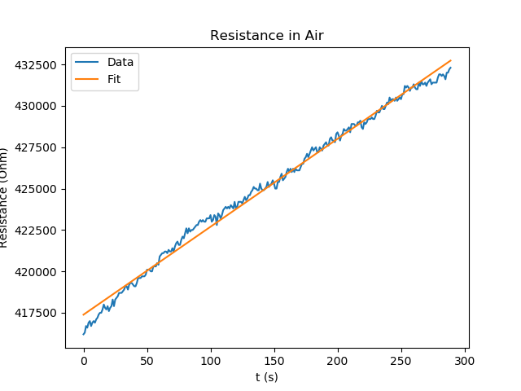
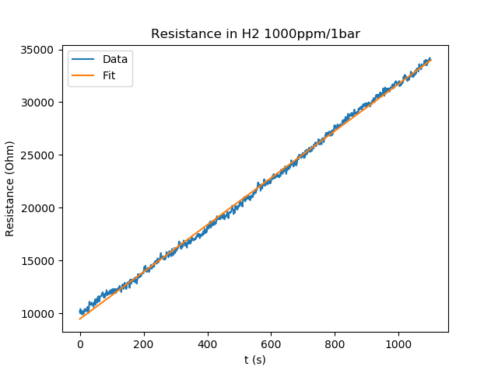
Reaction to 1000ppm 1 bar H2/Ar – 5.2V
0129_1623_2nd_sensor_airtoh2
Stable value in air and H2
Changing resistance in vacuum, probably due to temperature changes of the sensor due to the pressure changes and expanding gas
Part | R mean (Ohm) | Std
Air | 4.25E+05 | 4.46E+03
H2 | 2.17E+04 | 7.09E+03

Slide 4
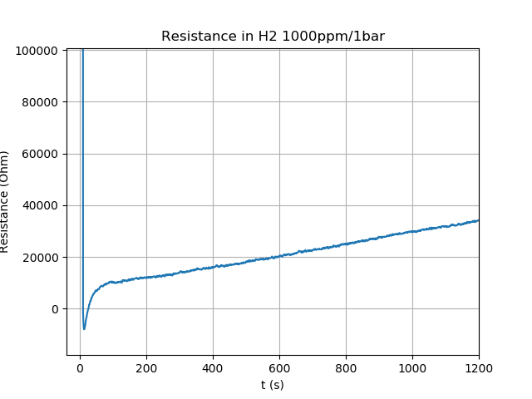
Reaction to 1000ppm 1 bar H2/Ar – 5.2V
0129_1623_2nd_sensor_airtoh2
Part | R mean (Ohm) | Std
Air | 4.25E+05 | 4.46E+03
H2 | 2.17E+04 | 7.09E+03

Slide 5
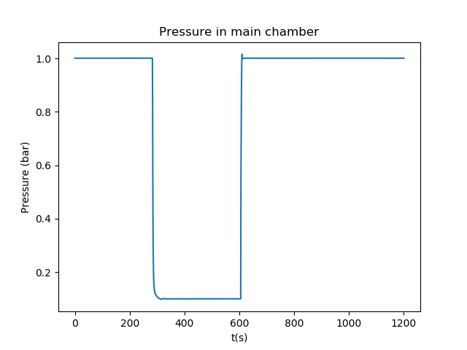
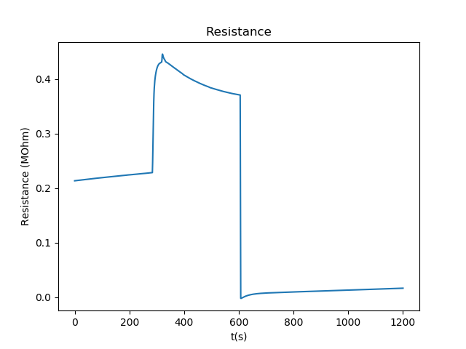
Stable value in Air – 5.3V
0129_1710_2nd_sensor_h2_5300mV
Similar behaviour to the measurement with 5.2V, but more clean as there was not increase in vacuum pressure
In vacuum, the resistance first increases, then drops
The increase can be caused by the drop in h2 concentration when going to vacuum due to the h2 in the ambient air (seems too low at 0.05 ppm Wiki Atmospheric chemistry) or simply the decrease in pressure
The decrease can be caused by the increased heating of the device as it cooled less by the surrounding air
Compare h2 value to datasheet

Slide 6
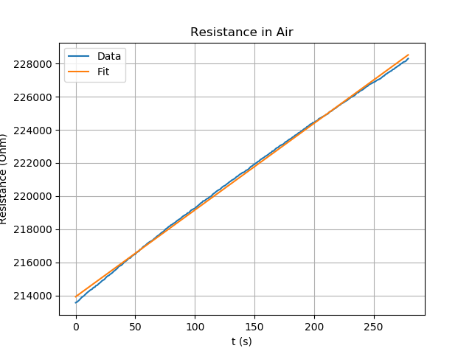
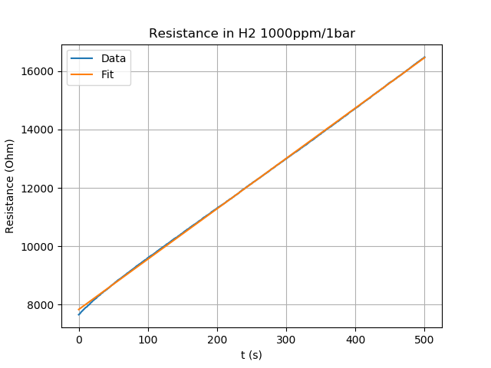
Stable value in Air – 5.3V
0129_1710_2nd_sensor_h2_5300mV
Measurement | Voltage heater (V) | C_h2 (ppm) | Pressure (bar) | Part | R mean (Ohm) | Std | a | b
0129_1710_2nd_sensor_h2_5300mV | 5.3 | 1000 | 1 | Air | 2.21E+05 | 4.23E+03 | 52.3472 | 213921
0129_1710_2nd_sensor_h2_5300mV | 5.3 | 1000 | 1 | H2 | 1.21E+04 | 2.49E+03 | 17.2475 | 7834.9

Slide 7
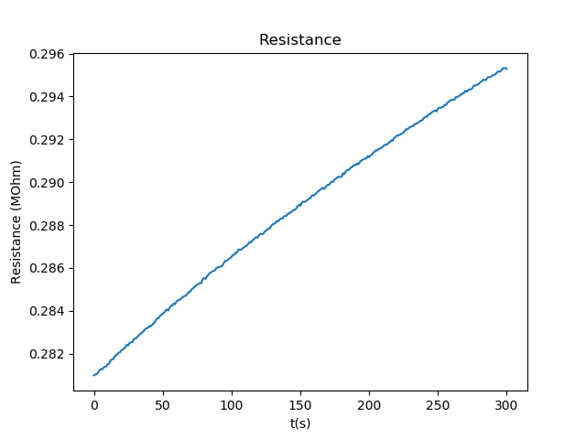
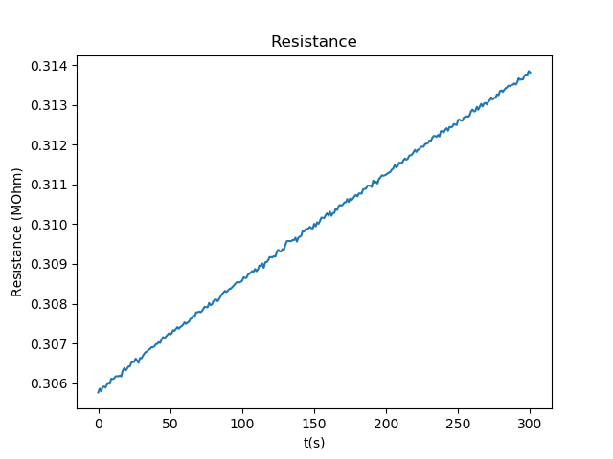
Resistance in Air – 5.3V (30/01)
14:30
14:40
Again slowly increasing, in the same range as with 5.2V (0.2-0.4 Mohm)

Slide 8
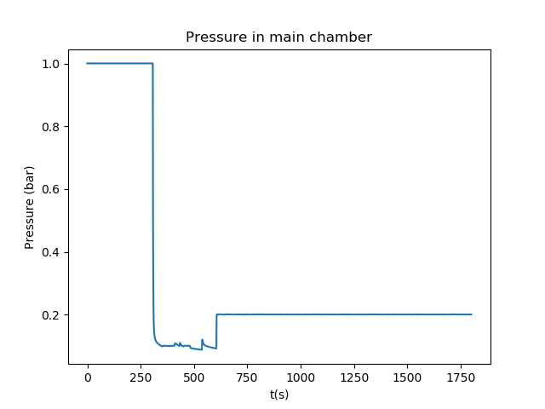
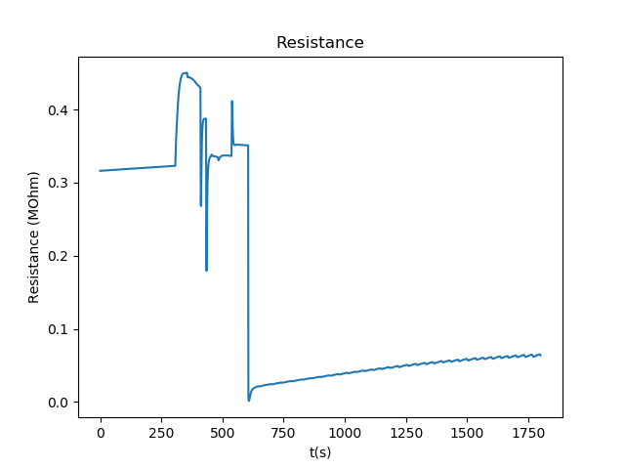
Reaction to 1000ppm/0.2bar H2
0130_1447_2nd_sensor_airtoh2_2V
Vacuum part is messy due to small increases caused by pumping other chambers
Starting resistance is higher than before (0.2 vs. 0.3 MOhm)
Resistance is slowly increasing in H2 and contains bumps
The bumps could be caused by the pressure controller regulating the pressure
Compare h2 value to datasheet

Slide 9
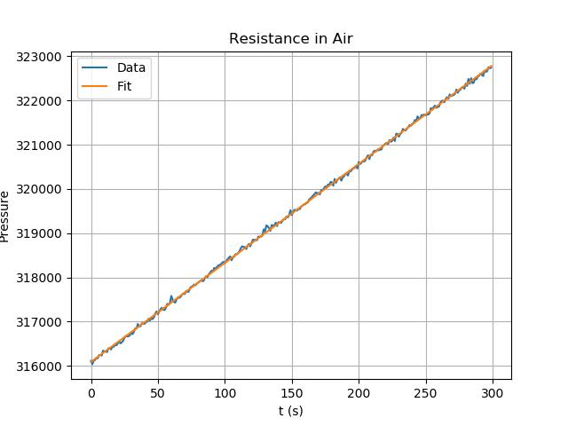
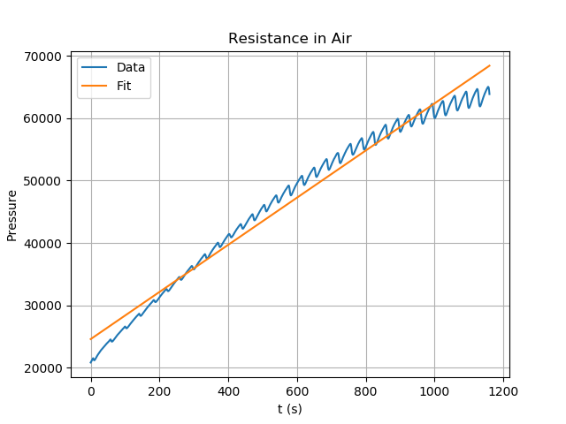
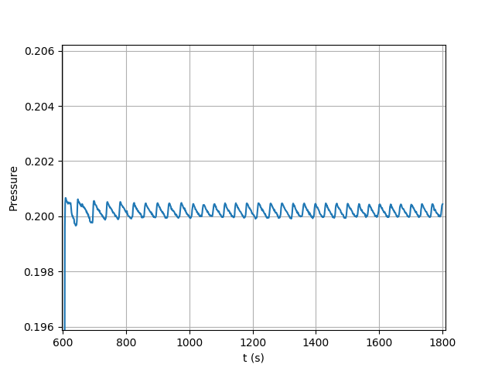
Reaction to 1000ppm/0.2bar H2
0130_1447_2nd_sensor_airtoh2_2V
Measurement | Voltage heater (V) | C_h2 (ppm) | Pressure (bar) | Part | R mean (Ohm) | Std | a | b
0130_1447_2nd_sensor_airtoh2_2V | 5.2 | 1000 | 0.2 | Air | 3.19E+05 | 1.94E+03 | 22.3684 | 316090
0130_1447_2nd_sensor_airtoh2_2V | 5.2 | 1000 | 0.2 | H2 | 4.65E+04 | 1.28E+04 | 37.8127 | 24572.1
Pressure during h2 phase

Slide 10
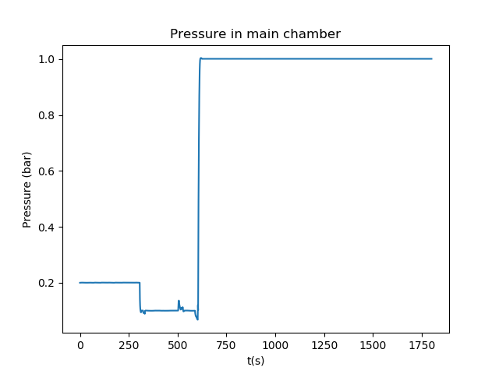
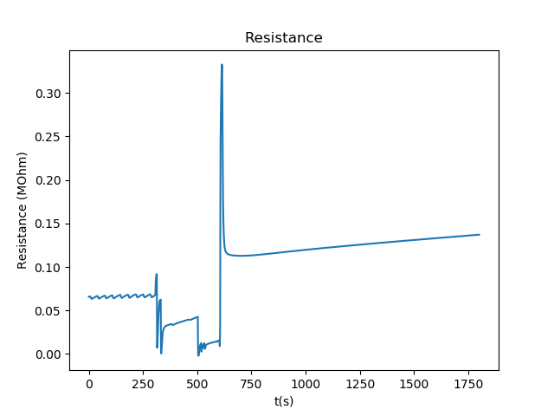
Recovery from 1000ppm/0.2bar H2
0130_1517_2nd_sensor_h2toair_2V
Ripples in H2 still present
Changes in vacuum pressure make that part of the measurement messy
Sharp peak when air is introduced, exact cause of increase unknown, which gas makes it react this way
Afterwards the device probably cools down rapidly due to expanding air and then slowly heats up again

Slide 11
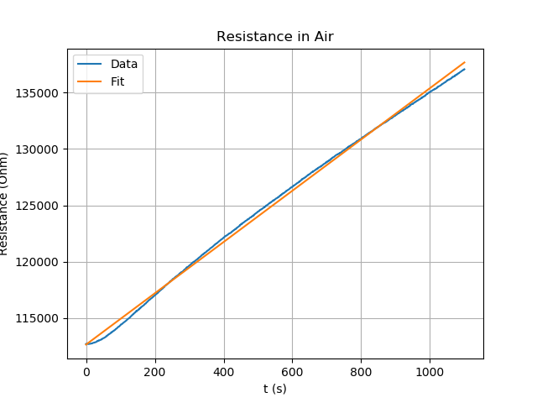
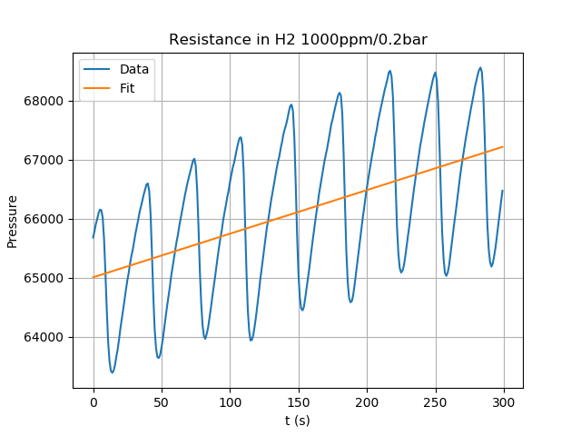
Recovery from 1000ppm/0.2bar H2
0130_1517_2nd_sensor_h2toair_2V
Measurement | Voltage heater (V) | C_h2 (ppm) | Pressure (bar) | Part | R mean (Ohm) | Std | a | b
0130_1517_2nd_sensor_h2toair_2V | 5.2 | 1000 | 0.2 | H2 | 6.61E+04 | 1.30E+03 | 7.38613 | 65004.9
0130_1517_2nd_sensor_h2toair_2V | 5.2 | 1000 | 0.2 | Air | 1.25E+05 | 7.23E+03 | 22.7318 | 112658

Slide 12
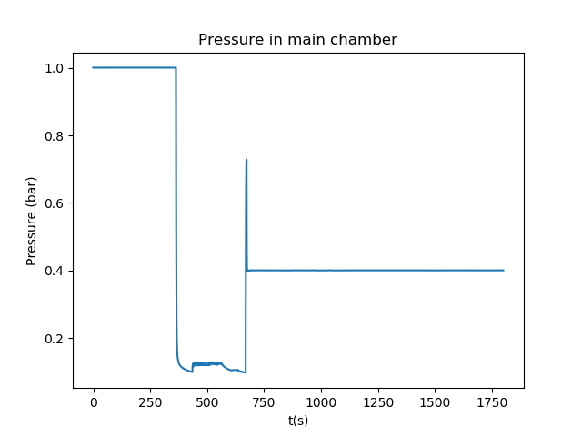
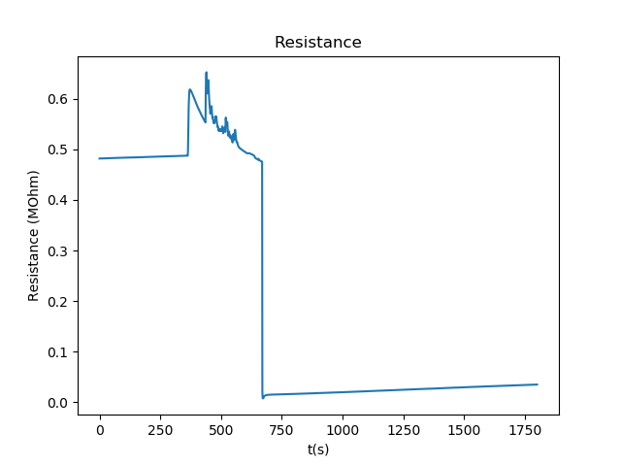
Reaction to 500ppm/0.4bar H2
0130_1643_2nd_sensor_airto05h2_4V
Incoming gas has the same partial pressure of hydrogen (half the concentration, but twice the total pressure
Resistance stable in air, slowly increasing in h2 (caused by heating after expanding gas)
Extract mean and std resistance in air and hydrogen
Compare hydrogen value to datasheet

